Slide 1
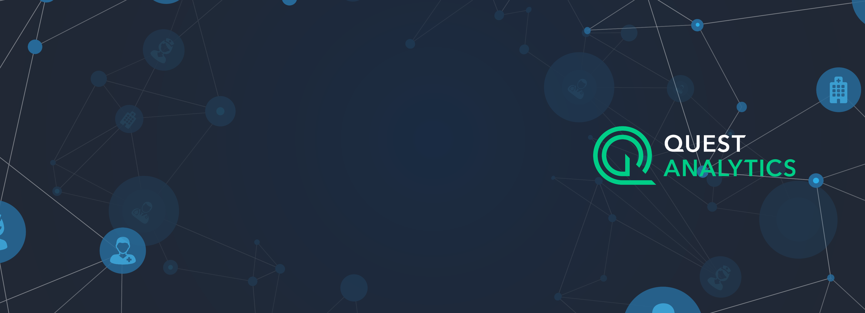
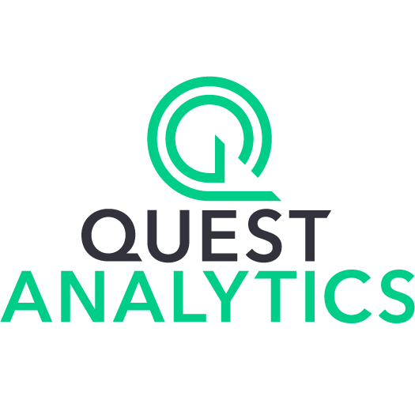
Customer:
Quest Analytics
Industry:
Partner Professional Services
Size:
50–999 employees
Country:
United States
Products and services:
Microsoft Azure
Microsoft Azure SQL Database Hyperscale
Read full story here
“Separating compute and storage has also allowed us to reinvest some of those savings, and we can actually expand our intellectual property and what products and services we offer in the market.”
—David Pracuta, Vice President of Cloud Operations, Quest Analytics
Quest Analytics offers software as a service solutions to payers and providers in the healthcare industry. It helps customers manage complex provider networks, but the company needed more scalability, compute, and speed in its database.
The company already used Microsoft Azure SQL Database, and it decided to upgrade to the Hyperscale service tier, which allows applications with large data capacity requirements to automatically scale storage and compute resources.
Quest Analytics now has better control of its usage and costs, so its staff spends less time managing databases and more time developing innovative offerings. The company also delivers results to customers faster, speeding customer decision making.

